Slide 1
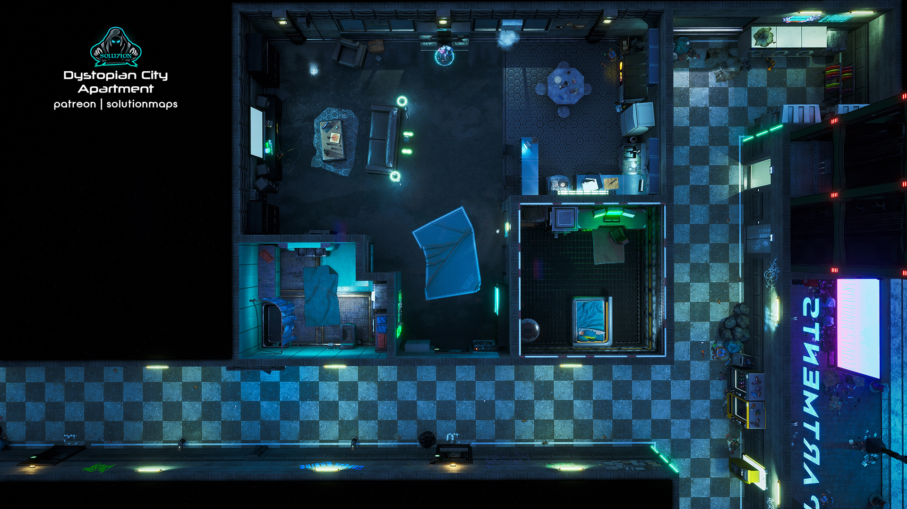
The Plot A trid star researching shadowrunners is targeted for abduction. The Job: Escort the client on a shadowrun and protect them.. The Pay: 500¥ up front, 1000¥ for the star’s safety, bonuses for “an authentic experience” and delivering the artifact. .
Scene 1 (Social). Setting: Dante's Inferno, Downtown. The Hook: Runners were told by their fixers to meet here. Given dossiers with images, major skills, names of the rest of the team (have players introduce their characters). Events: Influence + CHA (3) – Bartender directs the player to a back room where Mr. Johnson along with Jason McClont. Mr. Johnson has lined up the experience: a milk-run smash-and-grab to acquire any magical artifacts from a small-time Renraku exec's apartment. Negotiation: per SMG p16, vs Influence 5 CHA 6, 5% increase/decrease in base pay per hit (max still 3k per SMG).
Scene 2 (Investigation). Setting: per players. Available Info:
McClont has a number of guest appearances on popular trid serials, mostly police procedurals. He's also starred in a few 'direct to home' productions.
The Renraku Exec, Akemi Hirogashi, has just been promoted to junior regional manager of Kogane, a Renraku subsidiary that operates fashion boutiques.
Hirogashi is decended from a line of Japanese martial artists. They specalized in an applied form of kenjutsu.
Hirogashi lives in a Renraku subsidiary-held apartment complex downtown. Security is Rating A (CRB 239) plus a street samurai doorman and a physad concierge.
Hirogashi is reportedly dating a Red Samurai.
The building: lowest 5 floors are a shopping mall, then apartments. Underground parking for 5 floors.
Optional Rules for Initiative. Purpose: Get all players involved in all scenes at First Taste. Social: Influence + CHA. # hits determines order. Ties: Edge, CHA, INT, Coin Flip. Investigation: Perception + INT. # hits determines order. Ties: Edge, INT, REA, Coin Flip.
Scene 3 (Investigation). Setting: The Apartment Complex. Edge: 1 per 2 successes in Scene 2 for each player (max 2). Challenges:
Shopping mall entrance: R1 SIN scanner, R3 Chemsniffer.
Residental area lobby: NPCs per left, R4 SIN Scanner, R4 Chemsniffer.
Matrix: R6 host for shopping mall, average IC + on-call spider. Separate slaved R5 host for bldg.
Magic: wards on residential floors with rare spirit patrols.
Take Two
A Shadowrun 6e First Taste by Zeshan Rajput
https://creativecommons.org/licenses/by-sa/3.0/
CRB: Shadowrun 6th Edition Core Rule Book
SMG: Shadowrun Missions Guide v1.6
Map Credit: SolutionMaps on Patreon
Scene 4 (Combat). Setting: The apartment once HTR is triggered. Edge: 1 per player if they get advanced notice, 1 more (max 2) if they set up an ambush. Challenges: 1 enemy per player (max 4). Choose from: Patrolman (CRB 206), Decker (CRB 205), Combat Mage (CRB 206), SWAT Officer (CRB 206). McClont has 2 in all stats, 4 in Con (Acting), and no weapons. He will not participate in combat other than to run and hide.
Picking Up the Pieces. Pay: negotiated pay. Max 3k per player.Karma: 3 karma for adventure survival.
Contacts: Jason McClont, Connections 2 Media Personality.

